Slide 1
Running a Federal
Election Campaign
Notes:
SAY: Welcome to this presentation on Running an Election Campaign.
INTRODUCE YOURSELF

Slide 2
Objectives
Give you an understanding of what the high level strategy could look like on a campaign
Help you start to realize the kinds of skills and resources involved in running a campaign
Notes:
SAY: This presentation is about some of the things involved in running a federal election campaign.
It is geared towards people who want to participate in a federal election campaign either as a candidate themselves or as a member of a campaign team. Throughout the presentation I will speak directly to things candidates might do themselves as part of their campaign, but if you’re here to learn about the process so that you can support a candidate, these things will apply to you as well.
This presentation is meant to:
Give you an understanding of what the high level strategy could look like on a campaign, that is: which activities you might want to prioritize, what the timeline looks like, and what a campaign team looks like;
Help you start to realize the kinds of skills and resources involved in running a campaign: the kind of team you’ll need to assemble, and the kind of money you might need.
EXPLAIN: This presentation is not meant to give you a cookie-cutter campaign plan. Elections Canada developed it through consultation with people who had experience running and working on election campaigns. The aim is that you leave this presentation with enough of an understanding of where to begin and where to turn for support to resolve the kinds of challenges you’re bound to encounter while launching and running a campaign.
Hopefully, this presentation will help clarify some of the steps involved in becoming and being a candidate, and specifically in running a campaign.

Slide 3
Agenda
Timeline
Party candidacy VS independent candidacy
Party nominations
General election campaign strategy
  Organizing: the three games
  Resources: money & volunteers
Building a campaign team
Notes:
SAY: Here’s an outline of what we’ll talk about (READ SLIDE)

Slide 4
You probably have already reached a few check-points on your path to running an election campaign:
1
You’ve already decided to run or work on a campaign
2
You know what you stand for and “why” you’re running, or why you’re supporting a particular candidate’s campaign
3
You don’t have experience around electoral campaigns
4
That you (or your candidate) are already the ideal candidate
Notes:
SAY: This presentation assumes you have already reached a few check-points on your path to running an election campaign:
1. You’ve already decided to run or work on a campaign. We’re here to discuss what a campaign looks like once that decision has been made.
2. You know what you stand for and ‘why’ you’re running, or why you’re supporting a particular candidate’s campaign. We won’t explore taking stances on issues, how to choose a party, or ideology.
3. You don’t have experience around electoral campaigns. We’ll be talking about some of the less intuitive pieces of knowledge related to running an election campaign to help you avoid some of the ‘rookie mistakes’ that new candidates can make.
4. That you (or your candidate) are already the ideal candidate. That means we’re not going to focus on what makes a candidate ‘electable’. The focus will be on how to organize a campaign around an already competent candidate.

Slide 5
Candidacy Timeline
Announce your intent to run
(Secure party endorsement)
Writ drop (official campaign launch)
Election day
Register as a candidate
Notes:
SAY: Let’s start with a look at the timeline for becoming and being a candidate.
To become a candidate, the first step is to announce your intentions to seek a party nomination or be an independent candidate. This usually happens before the start of the election, during the period known as pre-writ. This means it is before the writ is issued by the Chief Electoral Officer announcing the start of the election period.
The second step is to secure the endorsement of a political party, if you’ve decided to run as a candidate for a party. You might have to go through a nomination campaign. We’ll discuss that more later.
Next, the writ will be issued by the Chief Electoral Officer which marks the official launch of the election campaign.
Once the writ has dropped, you’ll need to register as an official candidate with the returning officer in the electoral district where you’ll run. You have until the 21st day of the election period to do this.
Finally, there’s election day! Of course, there are other steps to follow after the election campaign, but we won’t get too into those details today.

Slide 6
Independent
VS.
Party Candidate
Notes:
SAY:
Before we move on, does anyone have any questions about the differences between running as an independent or as a party candidate?
NOTE FOR PRESENTER:
2 options:
Show video on next slide (Slide 7)
Go through Slides 8 to 17, as they are based on the video transcripts for this video
IF VIDEO IS USED:
SAY: The first step to running in an election is to decide whether you will run as a candidate for a political party or as an independent candidate. Let’s take a few minutes to watch this quick video to learn more: (link to video) GO TO NEXT SLIDE
IF NO VIDEO:
SAY: To run for Parliament, you need to first get your name on the ballot. This process will vary depending on whether you run as the candidate for a political party, or as an independent candidate. SKIP TO SLIDE 8

Slide 7
Video
Elections Canada - Launching your Bid for Parliament
Notes:
NOTE FOR PRESENTER:
The above video is also available in the Journey to Running in a Federal Election guide on the Inspire Democracy website (www.inspiredemocracy.ca). If you show the video in the presentation, you can skip slides 8 to 17, as it covers the exact same content.
If you are not able to present the video, please go through Slides 8 to 17.

Slide 8
General Elections 1997-2015
Elected independent candidates
Elected party candidates
5
2,167
Notes:
IF NOT USING VIDEO ON SLIDE 7.
Say: Since 1997, there have been just five independent candidates elected to the House of Commons. During this time, Canadians have mostly been represented by Members of Parliament who belong to a political party.

Slide 9
Independent
Candidates
Not affiliated with any political party
Build a campaign team from scratch
Identify where you stand on various issues
Secure the necessary resources and expertise
Notes:
IF NOT USING VIDEO ON SLIDE 7.
Say: Independent candidates are not affiliated with any political party. If you run for Parliament as an independent candidate, you are responsible for everything to do with your campaign. You’ll need to build a campaign team from scratch, identify where you stand on various issues, and secure the necessary resources and expertise in order to run your campaign. If you win your election, you won’t have a party-caucus to depend on for extra support, nor will any party caucus expect you to behave in a certain way.
So, whether it’s during the campaign, or afterward, Independents bear the burden and the freedom of going it alone.

Slide 10
Party
Candidates
Group of people who share a common vision about how the country should be governed
You become the local representative for your party’s vision
Notes:
IF NOT USING VIDEO ON SLIDE 7.
Say: If you run for Parliament as a candidate for a political party, things will work differently.
A political party is a group of people who share a common vision about how the country should be governed. This vision is what attracts many people to become members and candidates for a party. In Canada, there are many different political parties to choose from. By stepping up to be a candidate for the party, you become the local representative for your party’s vision.

Slide 11
Party
Candidates
(continued)
During an election, the party’s candidates share:
Resources
A platform
A national brand
The goal of uniting behind the campaign for its leader to
become the Prime Minister
When you run for a party, you’ll have the party’s support.
Most parties also expect you to ask your own networks for donations, volunteer support and voter support
Notes:
IF NOT USING VIDEO ON SLIDE 7.
Say: During an election, the party’s candidates share things: resources, a platform, a national brand, and the goal of uniting behind the campaign for its leader to become the Prime Minister.
When you run for a party, you’ll have that party’s support. In some cases, the party’s existing volunteers, donors and supporters may also want to support your campaign with their time, money and votes.
While that support can help, most parties also expect you to ask your own networks for donations, volunteer support and voter support.
If you win your election, you’ll generally be expected to work with other elected members of your party to advance the issues that are important to the party, often at the direction of the party leadership.
Whether it’s during the campaign or after your election, being a party candidate or one of a party’s elected MPs likely means having the support that comes with being part of a team, along with some added responsibilities and expectations that you could be asked to take on.

Slide 12
To become a candidate in the general election, candidates must:
Complete the process outlined by Elections Canada to register as a candidate
Secure enough signatures from Canadian citizens that are
18 years or older in their electoral district
Secure the endorsement of that political party
(if you want to be a candidate for a political party)
Notes:
IF NOT USING VIDEO ON SLIDE 7.
Say:
To become a candidate in the general election, party candidates and independent candidates must both complete the process outlined by Elections Canada to register as a candidate. This includes securing enough signatures from Canadian citizens that are 18 years or older in their electoral district.
If you want to be a candidate for a political party, you’ll have to first secure the endorsement of that political party.
Generally, parties decide whether to hold a nomination contest or simply to select a candidate.
If a party has a strong local presence, and an active membership in the district, it is more likely that a nomination contest will be held to select its candidate.

Slide 13
Party Nominations
1. Connect with a party
2. Get vetted
3. Secure nomination
Notes:
IF NOT USING VIDEO ON SLIDE 7.
Say:
While the route to becoming the candidate is slightly different within each party, the overall process is the same. It generally involves connecting with a party, being vetted and running a successful nomination campaign.
While everyone who runs for Parliament can eventually end up with their name on a ballot, there are different paths that lead them there. For independent candidates, it’s a straightforward path. For party candidates it involves securing the endorsement of the party you wish to run for, and sometimes that involves competing with other party members for the party’s nomination.

Slide 14
Party Nominations
1. Connect with a party
2. Get vetted
3. Secure nomination
Notes:
IF NOT USING VIDEO ON SLIDE 7.
Say:
First, you’ll need to reach out to the party and indicate your interest in being a candidate.
Some people think that the party must reach out to you first. While that is often the case, there have been MPs from many parties who didn’t wait for the party to approach them. It can, and does, work both ways.
Once you’ve connected with a party, you can learn more about the specific process that party uses to nominate its candidates.

Slide 15
Party Nominations
1. Connect with a party
2. Get vetted
3. Secure nomination
Notes:
IF NOT USING VIDEO ON SLIDE 7.
Say:
Most of the larger parties – parties with elected members in the House of Commons - will vet anyone who expresses a serious interest in being a candidate before allowing them to enter the nomination race.
This means that they’ll be looking at your credentials and your community activities to determine if you represent the values and policies of their party before going to the next step.
As part of this process they will likely ask you to complete paperwork. They may also look for things you’ve said or written on social media or in the press, they may contact people you’ve worked for and with, and they may interview you once, or multiple times.

Slide 16
Party Nominations
1. Connect with a party
2. Get vetted
3. Secure nomination
Notes:
IF NOT USING VIDEO ON SLIDE 7.
Say:
Once you receive approval to seek the party nomination, you can start your campaign. This usually happens before the general election campaign.
Running in a party nomination contest is about earning enough votes from party members to become its candidate.
In most cases, only party members can vote in a nomination contest. But anyone who lives in the electoral district and is old enough to be a member can join the party and vote according to party rules.
For this reason, most nomination campaigns focus on recruiting as many new members to the party as possible to support their candidacy.
The party will set a timeline by which new members have to be registered, and a date for the nomination meeting, when party members will cast their ballots. It is important to understand the party nomination process
and key dates.

Slide 17
Next Steps
Pre-election period
Build your team
Connect with voters
Prepare for upcoming elections
Register as a candidate with your local Elections Canada returning officer
Election period
Notes:
IF NOT USING VIDEO ON SLIDE 7.
Say:
Whether you’re an independent candidate, or you’ve been successful in being nominated by a party, the steps from here on in are the same. Once the writ is issued, you’ll need to register as candidate with your local Elections Canada returning officer.
Before the writ is issued, there is nothing stopping you from building your team, connecting with voters in your electoral district, and preparing for the upcoming election.
We are going to talk about doing just that, next!
ASK: But first, does anyone have any questions about the differences between running as an independent or as a party candidate?

Slide 18
The Three Games
Name Game – Persuasion Game – Ground Game
Notes:
SAY:
There are three games involved in campaigning.
1. The Name Game: Making sure voters know who you are, and can name your party affiliation. That means they know which party you’re running with, or that you’re an independent candidate.
2. The Persuasion Game: This is persuading voters to support you and/or your party
3. The Ground Game: Identifying your supporters and ensuring that their support translates into votes
These games are not mutually exclusive – their activities often overlap.

Slide 19
The Name Game
?
Do voters know your name?
If you are a party candidate, do people know enough to match your name with the name of your party?
If you’re an independent candidate, do voters think
“Ah, the independent candidate!” when they hear your name?
People who don’t know your name probably won’t vote
for you.
?
?
Notes:
SAY:
The name game is about getting voters to know your name.
The questions your campaign should ask are:
Do voter’s know your name?
If you are a party candidate do people know enough to match your name with the name of your party?
If you’re an independent candidate, do voters think ‘Ah, the independent candidate!’ when they hear your name?
The field of play for this game is in the physical space of the electoral district and the digital space of online forums and groups, social media, and community webpages.
The activities for this game involve: Signage, digital advertisements, traffic/transit waves at busy intersections/transit terminals, marching in parades, having a visible presence in the community during and leading up to the election.
The key players in this game are the members of your campaign team.

Slide 20
The Persuasion Game
Does what happens in the press make voters more or less likely to vote for you? This is also known as the air game.
When you meet voters and pitch your campaign, are
they supportive?
When asked by pollsters, are voters expressing the intention to support you?
Voters who don’t know what you (and your party) are about won’t vote for you.
?
?
?
Notes:
SAY:
The persuasion game is about getting people to support and vote for you.
In a federal election, the persuasion game is heavily influenced by party leaders
Local party candidates will see their own support rise and fall with their party’s and leader’s public support.
Independent candidates must work harder to be seen as players in this (and every) game.
The questions your campaign should ask are:
Does what happens in the press make voters more or less likely to vote for you? This is also known as the air game.
When you meet voters and pitch your campaign, are they supportive?
When asked by pollsters are voters expressing the intention to support you?
The field of play for this game is in national and local press, on the doorsteps of the residents in your electoral district, through digital media, and by word of mouth.
The activities for this game involve: Candidate door-knocking, pitching stories to local journalists, press releases, social media postings, open-houses, meet-and-greets.
The key players in this game are the party leader, you, the candidate, and support from your campaign teams.

Slide 21
The Ground Game
Will you pull more of your supporters out to vote than
your opponents?
You can’t win an election if your supporters don’t vote
(for you).
?
Notes:
SAY:
Many voters will need to be reminded, nudged, and shuttled to polling stations when it comes time to vote on or before Election Day.
The question your campaign should ask are: Will you pull more of your supporters out to vote than your opponents?
The field of play for this game is on doorsteps, through telephone calls, email lists, and polling stations.
The activities for this game involve: driving voters to the polls, reminder phone calls, door-knocks, literature drops, developing voting plans, securing vote pledges, election-day email blasts…
The key players in this game are your campaign team, including many volunteers.
ASK:
Before we move on, do you have any questions about these three games, and what is involved in each?

Slide 22
Campaign Resources
Financial resources
Human resources (volunteers)
Notes:
SAY:
Before we get to the campaign team’s work, we should talk about the kind of resources a campaign typically needs: money and volunteers.
Money pays for things like a campaign office space, signage, promotional materials, a website, wages for senior campaign positions and meals for volunteers.
In the 2015 election, the average campaign raised and spent between 70,000 and 90,000 dollars.
Volunteers play an important role in campaigns, and many campaigns will have 100 or more volunteers.
So where might a campaign find money and volunteers?

Slide 23
Party Support &
Personal Appeals
Notes:
SAY:
As an independent candidate, you’ll need to appeal to people in your community, including your family and friends, for financial and volunteer support. As a candidate for a political party, you may be able to also rely on support from the party.

Slide 24
Party
Support
Know what you can expect and ask of the party you
run with.
Local party
National party
Notes:
SAY:
Party candidates may be able to lean on the local party and the national party for support in these areas during the campaign.
Local Party Support: members and supporters are likely to support your campaign with time and money
National Party Support: national campaigns will make decisions about which districts to invest in. This includes money, staff, volunteers, and visits from the party leader. All of these things can improve a local candidate’s chances of winning the election.
Some parties provide training to their candidates and campaign managers on things like data management, and fundraising.
Candidates should consider asking for additional support from the national campaign. Be ready to demonstrate how that investment is likely to pay off for the party and what you’re already doing to make your campaign a success.

Slide 25
Personal
Appeals
Be prepared to lean on
your network.
Test your assumptions.
Notes:
SAY:
Ultimately, take your own initiative to raise money and recruit volunteers. Before you get discouraged, test your assumptions about fundraising and volunteer recruitment. You may be surprised who gives and who doesn’t, how much they give, and why they give.

Slide 26
Team, Skills & Functions of a Campaign
Key skill areas
Campaign management
Identifying voters
Communications
Notes:
ASK:
Does anyone have any questions about the resources required for running election campaigns, and how to secure them?
SAY:
Let’s move on to the campaign team.
Building your campaign team is really just an exercise of planning for each of the three games – the name game, persuasion game, and ground game - and considering what kinds of skills and people you need in order to participate in each of those areas.
Some of the key skill areas we’ll explore today, are:
1. Communications: getting the message out with new media and traditional media
2. Identifying voters and getting out the vote / pulling the vote
3. Campaign Management

Slide 27
Campaign Management
3 roles
Candidates
Campaign Manager
Official Agent
Notes:
SAY:
Let’s start with campaign management. There are three roles involved in the management of a campaign: The candidate, the campaign manager, and the official agent.

Slide 28
Campaign Management
Candidate | Campaign Manager | Official Agent
Meeting voters to earn their support | Running the campaign effectively Oversight and support Team building Strategy and goal setting Liaise with candidate Appoint an official agent | Administration of the campaign financial transactions Reporting
Notes:
SAY:
The candidate and campaign manager have different jobs.
The candidate’s job will be to meet voters as often as possible to earn their support.
The campaign manager’s job is to maximize the amount of time the candidate spends engaging with voters by running the campaign effectively so the candidate spends the least amount of time as possible worrying about the campaign. The campaign manager oversees and supports everyone else on the campaign, and is responsible for ensuring the right people are in the right roles. This means setting and meeting goals and targets for fundraising, organizing voter outreach liaising between the candidate and campaign staff/volunteers, and overseeing the campaign strategy, operations, and spending.
A campaign will also need an official agent. The official agent is responsible for administering the campaign's financial transactions and reporting those transactions to Elections Canada as required by the Canada Elections Act.
Candidate’s need an official agent before they can:
accept contributions or loans for the campaign
spend money,
become an official candidate
Elections Canada developed a toolkit on the Journey to Running in a Federal Election which explains this role in more detail. There’s a link to this resource on your participant hand-out.

Slide 29
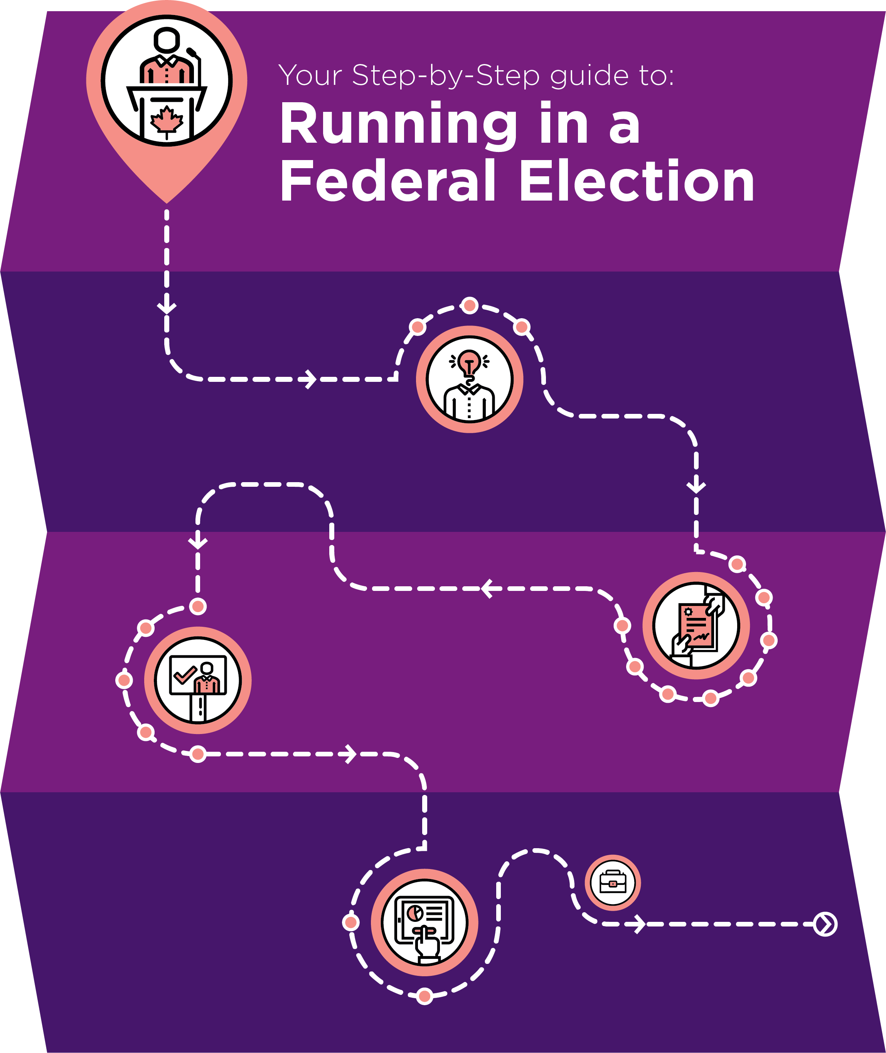
Campaign Management
Module 1:
Journey to Running in
a Federal Election
Notes:
SAY:
Elections Canada developed a toolkit on the Journey to Running in a Federal Election which explains the role of the Official Agent in more detail. There’s a link to this resource on your participant hand-out.

Slide 30
Sign Team
Responsible for ensuring signs are placed on supporters lawns, in allowable public spaces, and for repairing signs when they get damaged or vandalized.
Notes:
SAY:
Another important role on a campaign team is the sign team.
A sign captain and their team will be responsible for ensuring signs are placed on supporters lawns, in allowable public spaces, and for repairing and replacing signs when they get damaged or vandalized. Signs are a big part of the name game, they help voters learn your name as a candidate, and which party you represent (if you belong to one).
Signage is one of the simplest ways you can raise awareness about your campaign, but it’s only the beginning.

Slide 31
Campaign Communications
New Media | Traditional Media
Social media Digital advertising Videos | Direct-mail TV, radio, newspapers Speech, debate, interviews
Notes:
SAY:
Before people can vote for you, they also need to know what your campaign stands for - this is part of the persuasion game. A strong communications team can help you with that. Today, campaigns rely on new and traditional communications strategies in order to get the word out about their candidates.
To engage effectively in new media, you’ll want people on your team who understand:
- how to get the most out of social media,
- how to create and place targeted digital advertising, and
- how to create videos that can capture the attention of people you might otherwise miss.
When it comes to traditional communications strategies, you’ll also want people on your campaign who can help you:
develop direct-mail literature
get coverage from local television, radio and newspapers;
write speeches and prepare for debates;

Slide 32
Canvass Team
Door-knocking
High priority
Keep records
Persuade voters
Notes:
SAY:
Most importantly, your campaign will need to be prepared to reach out directly to voters. This is where the persuasion game meets the ground game.
Most competitive campaigns will ensure their candidate spends as much time as possible meeting voters in a door-to-door canvass.
Door-to-door canvassing can be a great opportunity to meet voters and hear their concerns.
However, the main reason most political campaigns conduct door-to-door canvassing is to ask and persuade voters for their support, and to keep a record of those who support the candidate for use in pulling the vote or get out the vote activities.
Elections Canada will give all candidates a copy of the voters list for their district. This list will be used to
help canvassers keep track of who they’ve met, and who they haven’t met; and
Identify if a supporter needs to register to vote (they won’t be on the list)
Make a record of whether a voter intends to support them on election day, or if they remain undecided.
It is important to remember that it is the responsibility of the candidates and parties to protect the personal information they have under their control. Political parties are required to inform Canadians on how they collect, protect and use the personal information of electors.

Slide 33
Data Management
To organize and store information collected: voters, donor, volunteer management, relationship management
Requires: human and technical resources (people & software)
Some parties have software (examples: Nationalbuilder,
Blue State Digital, NGPVan)
Notes:
SAY:
This is where data management comes in. Your campaign may need people and software dedicated to data management - organizing and storing information collected on the doorsteps about who voters intend to support.
Having a data management system is also important for keeping track of whether someone has requested a lawn sign, who has donated to the campaign and who wants to volunteer.
Some parties have such systems available to their candidates, and will usually provide some training, while other parties will not. Some common systems include:
Nationbuilder
Blue State Digital
NGPVan

Slide 34
GOVT Team (Get Out to Vote)
Collecting “vote pledges”
Helping voters develop their “voting plan”
Bringing supporters to the polls
Reminding supporters to vote
Notes:
SAY:
As Election Day approaches, usually a campaign’s priorities shift from persuading voters and identifying supporters to making sure those supporters make it to the polls to cast their ballots. These activities are often called Get Out the Vote (GOTV), or ‘pulling the vote.’ Since voters can now cast their ballots at a returning office as early as a few days after the official campaign period begins, pulling the vote activities can start as soon as campaigns identify a supporter.
These activities may include:
Collecting ‘vote pledges’
Helping voters develop their ‘voting plan’
Shuttling people to the polls, especially voters who are less likely to make it to the polls on their own (e.g. people with physical disabilities, elders without family, those without reliable transportation, etc.)
Phoning voters to ensure they vote.

Slide 35

Other Roles
Office Manager
Event Organizer
Scrutineers and Observers
Notes:
SAY:
There are many less-glamorous but important behind the scenes roles that are also critical to a campaign:
Office manager: keeps campaign office running smoothly - clean, organized, responding to inquiries, etc.
Event Organizer: schedules and manages meet and greets, campaign events, election day parties
Scrutineers and observers: to observe the voting and counting process at polling stations across the district

Slide 36
Summary
Running in a federal election is challenging and rewarding
It takes a committed team
Remember the three games
Elections Canada has resources to support your participation in the process
Notes:
SAY:
From the moment you decide to run to election day itself, running in a federal election is a challenging and rewarding experience. It takes not just a candidate, but a team of people who are committed to playing their part in the democratic process.
The way a campaign is organized varies from campaign to campaign. If you have a small team, the individuals on your campaign will likely each carry more responsibility than if you have a large team, and it will require some creativity as to how you assign roles and divide the work.
When in doubt, remember the main functions of the campaign, and the three games (name game, persuasion game, ground game). Early on (and prior to) the election, you want to focus your resources on raising awareness about your campaign, connecting with voters and making them aware of what your candidacy stands for. Once you’ve identified supporters, the process of ensuring they make it to the polls begins.
Elections Canada has resources to support your participation in the process - from the rules you’ll need to follow to stay within the law, and resources you can point to for supporting first time voters.

Slide 37
Questions?
Notes:
ASK: Do you have any questions about this presentation?
SHARE:
1. Running an election campaign – participant handouts
2. Link to Journey to Running in a Federal Election (inspire democracy website)
3. Elections Canada contact information:
Email: info@elections.ca
Telephone: 1-800-463-6868

