Slide 1
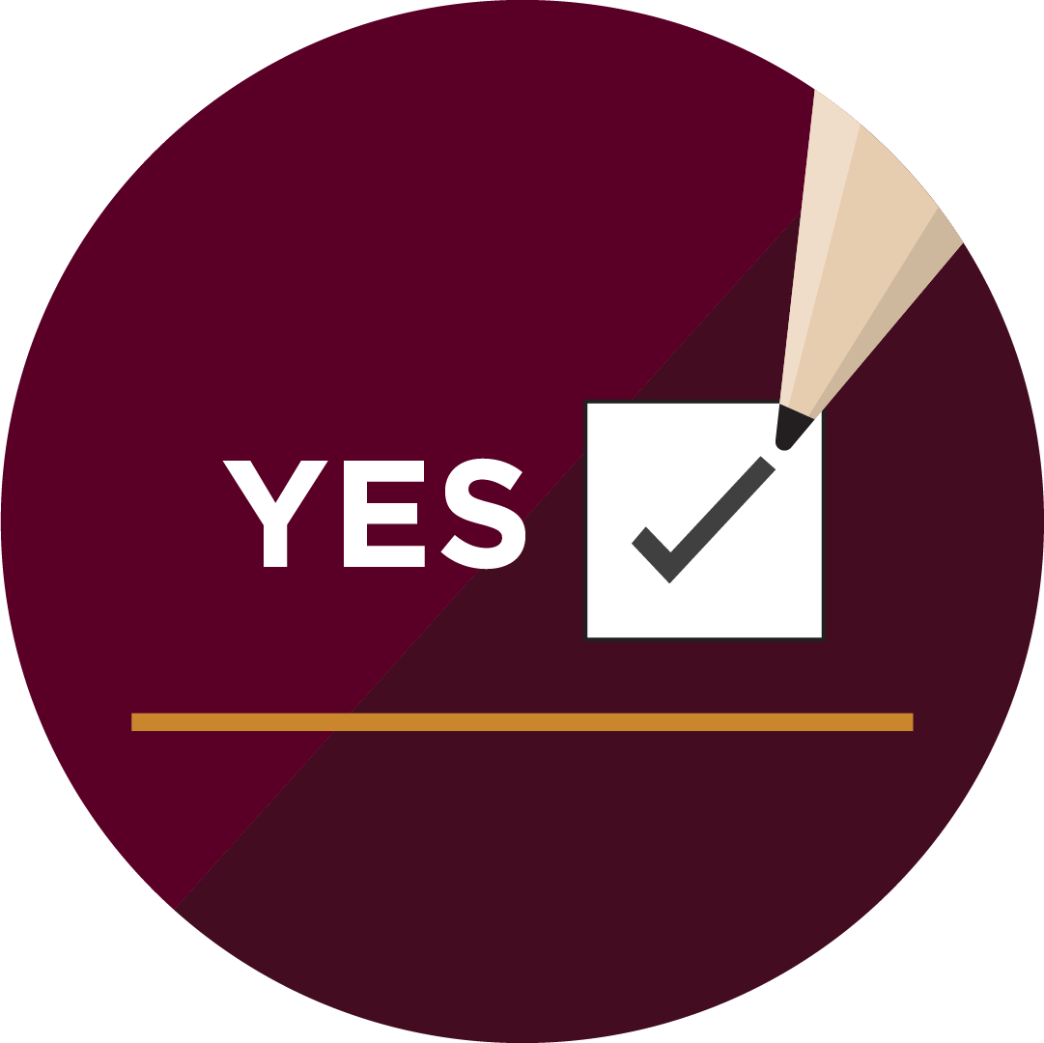
It’s tax season!
Did you know? You can be registered to vote in federal elections through your tax return!​

Slide 2
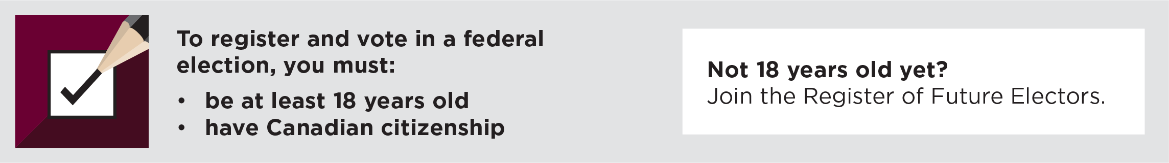
Filing your taxes? Check the boxes.
When filing your taxes, check “YES” to the two questions related
to Elections Canada.
By checking “YES”, you’ll be registered at your current address and ready to vote at a federal election.

Slide 3
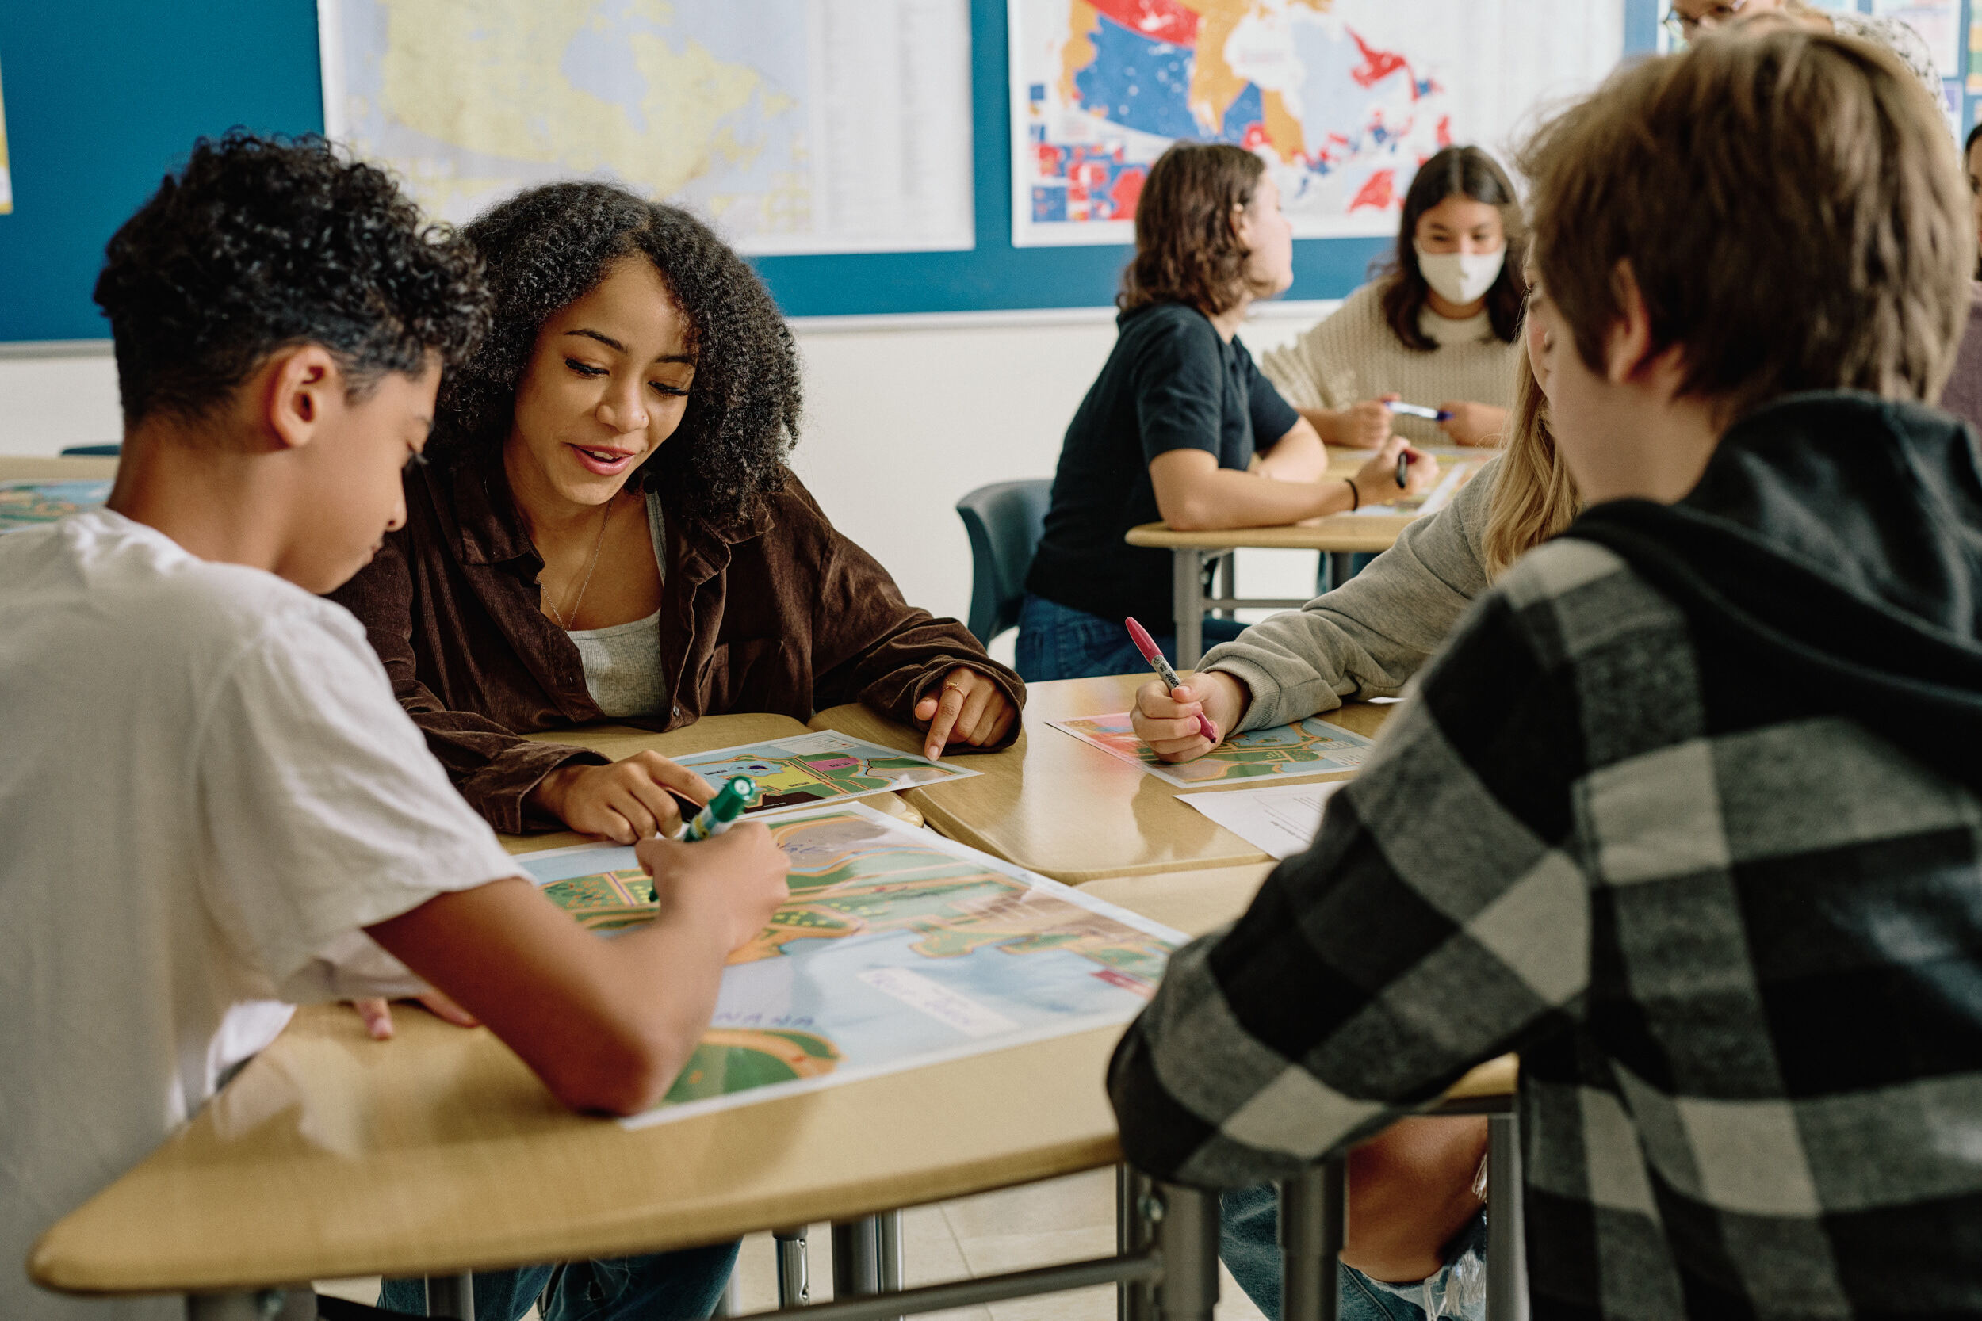
Register of Future Electors
The Register of Future Electors contains information on Canadian citizens aged between 14 and 17 who consented to register with Elections Canada.
Upon turning 18, their information will be added to the National Register of Electors to update the lists of electors for federal elections and referendums.

Slide 4
Registered to the Register of Future Electors
Canadian citizens 14-17 can check “YES” to the questions related to Elections Canada on their tax form.
Did you know?
Voting is habit forming.
18-year-olds who vote for the first time are likely to become lifelong voters.

